Slide 1

Cyber4Hire
Freelance Cybersecurity Services
Group Members: Niall, Jake, Ian

Slide 2
Introduction
Overview of Our Design: Our project, Cyber4Hire, is a secure, user-friendly web platform that connects businesses with qualified freelance cybersecurity professionals. We built a site that prioritizes strong security practices, user authentication, service verification, and an efficient search and review system to ensure trusted and high-quality connections.
Problem/Services Addressed: Today, businesses struggle to find trusted, skilled cybersecurity experts quickly and securely. At the same time, talented freelancers often face difficulty getting discovered. Cyber4Hire solves this by providing a secure, verified marketplace where companies can confidently hire cybersecurity help and freelancers can showcase their skills.

Slide 3
Project Structure Design
Client:
Built using PageLayer, a WordPress page builder plugin that allowed us to design custom pages through a drag-and-drop interface.
Our front-end is fully customized with HTML, CSS, and JavaScript components handled by PageLayer, providing users with an intuitive and responsive experience.
Users can browse cybersecurity freelancers, post service requests, leave reviews, and search for verified professionals in a catalogue created using WooCommerce.
User can make secure payments using Stripe as a payment gateway.

Slide 4
Project Structure Design
Server:
Hosted on InfinityFree, running WordPress on an Apache web server with PHP.
The server processes user interactions, manages sessions, and handles dynamic content generation securely.
Database:
Powered by MySQL through InfinityFree’s hosting service.
Stores critical data such as user profiles, service listings, verification statuses, reviews, and other dynamic content.

Slide 5
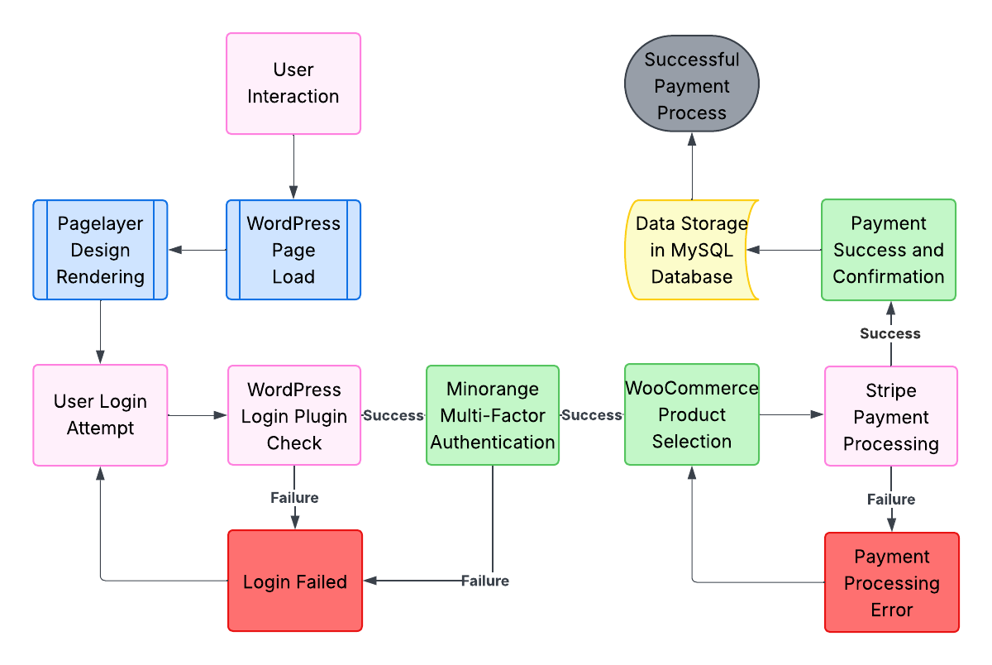
Project Structure Design

Slide 6
Results and Analysis
Achievements and Outcomes
We learned how to design an appealing and function website through the use of HTML and CSS (with the help of WordPress and plugins).
Our team as a whole has a stronger understanding of the importance of cybersecurity, especially when payment & confidential user information is involved.
In addition to this, we learned how to properly implement measures to strengthen the security of a website.
We were able to conduct thorough vulnerability assessments on our site using tools such as Nessus and Zap.
The reports could then be analyzed for critical vulnerabilities that may be present, giving us a better understanding of our website and what improvements can be made for the safety of its users.

Slide 7
Results and Analysis
Assessment Tools
We scanned and assessed our website using Nessus, Nmap, and Zap.
Provided is a video demonstrating and analyzing these scan results. Access the video here: https://youtu.be/ehkEmHcrnEk
No critical vulnerabilities were found on the site thanks to the WAF, secure login plugin, and multiple other security features provided by MalCare and Jetpack.
MalCare was also used on WordPress to detect potential vulnerabilities and implement solutions as needed.

Slide 8
Conclusion
Accomplishments & Takeaways
A fully made plan that we used for our E-Commerce website
A visually appealing eCommerce website that is fully completed and testably secure.
We learned how to analyze and check our website for vulnerabilities using various testing tools.
We learned about payment gateways, two-factor authentication, and CAPTCHAs and how to implement them into our future projects.
We learned about hosting a website, and configuring the SSL Certificate for our website.
We learned the importance of security and WAFS and how to implement them to increase the security of our website.

Slide 9
Conclusion
Activities Completed
Brainstorm website ideas for an untapped market (All)
Setup website hosting on InfinityFree (Jacob)
Configure SSL Certificate (Jacob)
Design website; Logo, UI, Theme, Text, etc. (Jacob)
Configure user registration and login (Ian)
Configure MFA using MiniOrange (Niall)
Configure website reCaptchas (Jacob)
Setup payment gateway (Jacob)
Design catalogue and populate with example products (Jacob)
Configure MalCare and Jetpack security protection plugins (Niall)
Conduct security scans to analyze website vulnerabilities (Ian)
Create presentation of website (All)

Slide 10
Resources
InfinityFree - Domain & Hosting
WordPress - Website Design & Plugins
Pagelayer - Page Design
PopularFX - Website Template
User Registration & Membership - Login & Registration
miniOrange - MFA
WooCommerce - eCommerce Toolkit
Stripe - Payment Gateway
CleanTalk - Anti-Spam
MalCare - Security Tools & Malware Protection
Jetpack - Security Tools
UpdraftPlus - Website Backup
Google Slides - Presentation
Lucidchart - Diagram Creation

Slide 11
References
WordPress documentation used for learning purposes.
Certain site images are royalty free images taken from Google Images.

Slide 12
Demo!

